Slide 1
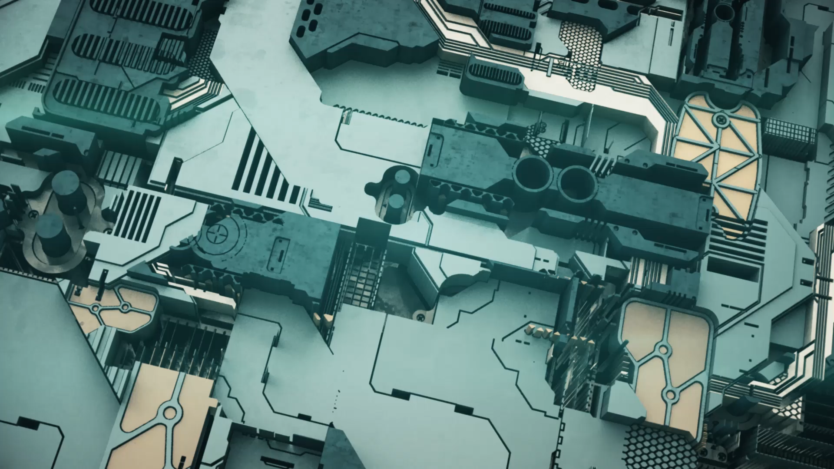
Deep dive into Transformers architecture
Presented by:
Japneet singh (japneets@gmail.com)

Slide 2


Slide 3
About me
~20 years of product development, mostly in Cybersecurity products
Currently employed with Lacework Inc., where I work on development of Cloud security solutions
In the past, I have been part of Microsoft Windows Defender, McAfee Anti-malware engine, FireEye Threat detection engine
I have had the opportunity to work on a variety of detection and protection technologies, which includes building sensors/agents, kernel drivers, ML based malware detection, cloud workload monitoring etc.

Slide 4

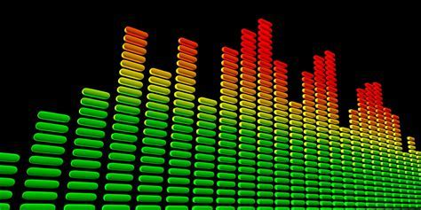
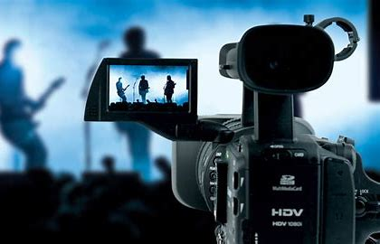
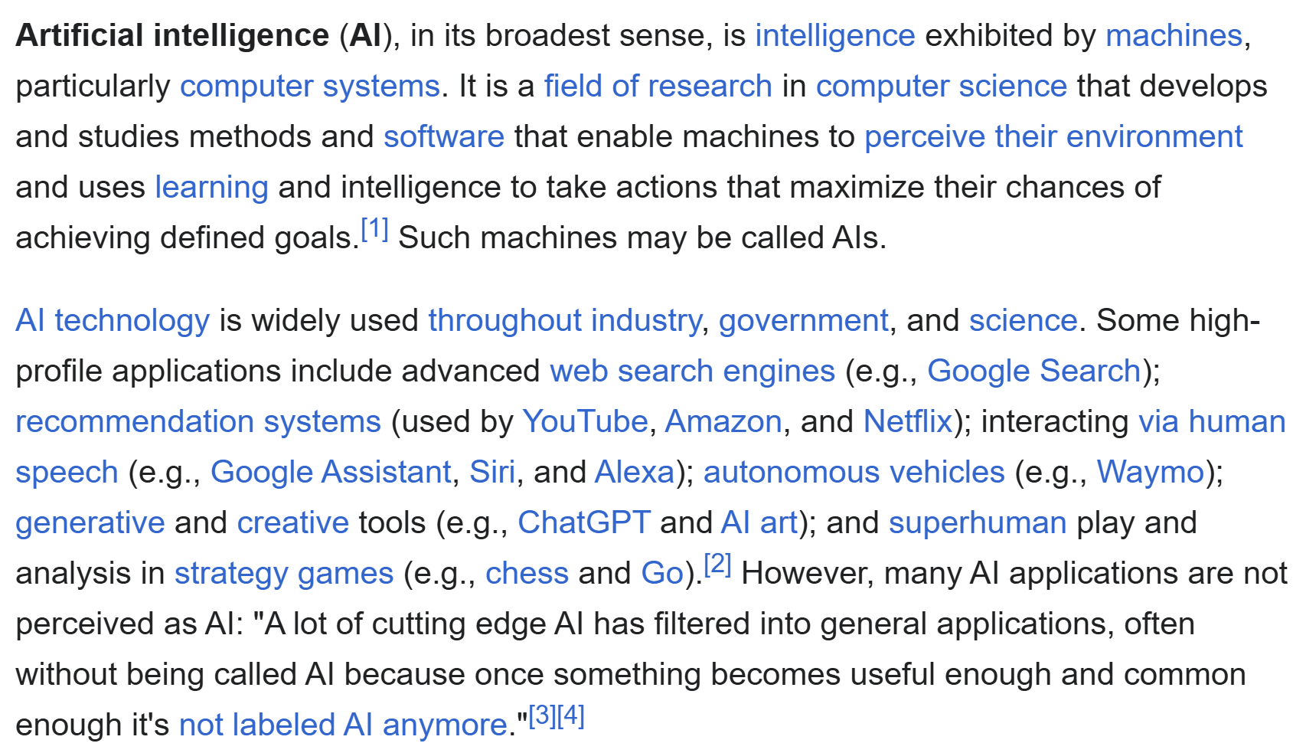
Introduction
Audio
Transformers are the workhorse of recent advancements in AI
Introduced for Language translation but now SOTA across modalities
The ‘T’ in GPT
We can only secure what we understand
Images
Language
Video
Notes:
Why am I here?

Slide 5
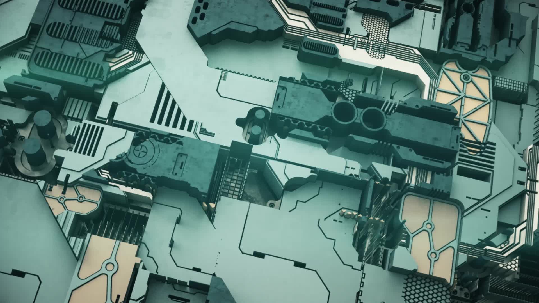
Agenda
Background
Transformers architecture
Inference and Training for Transformers (if time permits)

Slide 6
Disclaimer
There will be details
And there will be a bit of Maths

Slide 7
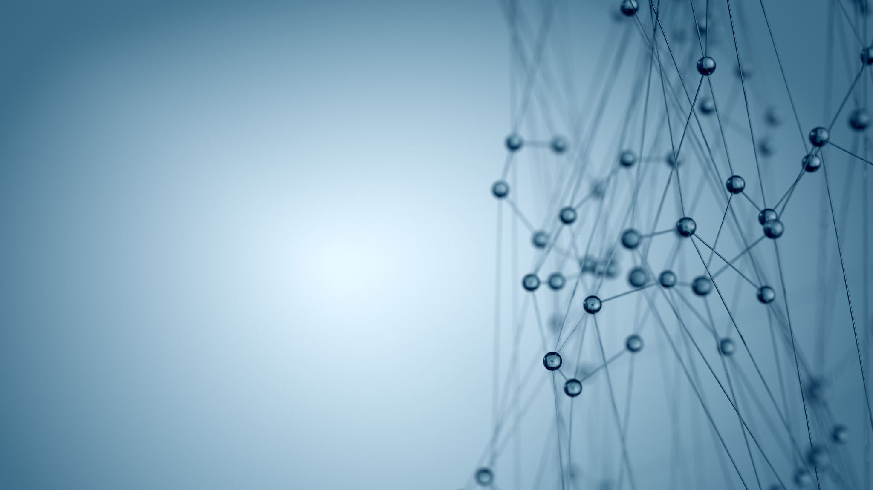
Background

Slide 8
Primers
Basic neural network
Sequence to sequence models
Recurrent neural networks and their problems

Slide 9
Neural network
Layer 0
Layer 1
Layer N-1
Layer N
∑
∑
x1
∑
∑
…
x2
∑
∑
x3
∑
∑
Input
Hidden
Hidden
Output
Notes:
Layers – input, hidden, output

Slide 10
Neural network
Layer 0
Layer 1
Layer N-1
Layer N
Weights
∑
∑
Output nodes
x1
Hidden nodes
∑
∑
…
x2
∑
∑
x3
∑
∑
Input nodes
Input
Hidden
Hidden
Output
Notes:
Weights are learned during network training

Slide 11
Training data
x1 | x2 | x3 | y1 | y2
1 | 0 | 1 | 1 | 0
1 | 1 | 0 | 1 | 0
0 | 0 | 0 | 0 | 0
1 | 1 | 1 | 1 | 0
1 | 0 | 0 | 1 | 1
0 | 1 | 0 | 0 | 1
1 | 0 | 1 | 1 | 1
0 | 1 | 1 | 0 | 1
Notes:
Inputs and outputs – supervised learning

Slide 12
Neural network training
Forward pass
Layer 0
Layer 1
Layer N-1
Layer N
∑
∑
x1
∑
∑
y1'
…
x2
Training data
∑
∑
y2'
x3
∑
∑
Input
Hidden
Hidden
Output
Notes:
Provide input for training data, and perform a prediction via Forward pass through the network. We obtain the outputs.

Slide 13
Neural network training
Forward pass
Layer 0
Layer 1
Layer N-1
Layer N
∑
∑
x1
∑
∑
y1'
…
x2
Loss = Y – Y`
∑
∑
y2'
x3
∑
∑
Input
Hidden
Hidden
Output
Notes:
Calculate the loss i.e. the difference between the actual expected outputs and the predicted outputs

Slide 14
Neural network training
Forward pass
Layer 0
Layer 1
Layer N-1
Layer N
Update weights
Update weights
∑
∑
x1
∑
∑
y1'
…
x2
Loss = Y – Y`
∑
∑
y2'
x3
∑
∑
Input
Hidden
Hidden
Output
Backpropagate loss
Notes:
Backpropagate the loss through the network thereby updating the weights

Slide 15
Neural network training
Layer 0
Forward pass
Layer 1
Layer N-1
Layer N
∑
∑
x1
∑
∑
Loss
Update weights
…
x2
∑
∑
x3
Backpropagate loss
∑
∑
Input
Hidden
Hidden
Output
Notes:
Repeat this enough times with a variety of data, and the weights get optimized. The network learns to map the inputs to the right outputs.

Slide 16
Neural network inference
Forward pass
Layer 0
Layer 1
Layer N-1
Layer N
∑
∑
x1
∑
∑
y1'
…
x2
Real data
∑
∑
y2'
x3
∑
∑
Input
Hidden
Hidden
Output
Notes:
Once network is trained, the weights are frozen. Inference is nothing but a prediction of outputs for the given inputs.
That’s a basic neural network.

Slide 17
Sequence to sequence models
Output sequence
Text/image/audio
Neural network
Text/image/audio
Input sequence
Notes:
A class of neural networks which learn to generate an output sequence based on a given input sequence.

Slide 18
Basic NN won’t work for sequences?
Layer 0
Layer 1
Layer N-1
Layer N
∑
∑
x1
∑
∑
…
x2
∑
∑
x3
∑
∑
Input
Hidden
Hidden
Output
Notes:
The NN we just saw won’t work for sequences

Slide 19
Basic NN won’t work for sequences?
Layer 0
Layer 1
Layer N-1
Layer N
∑
∑
x1
No dependence between inputs.
No concept of input ordering.
∑
∑
…
x2
∑
∑
x3
∑
∑
Input
Hidden
Hidden
Output
Notes:
A sequence has an inherent structure and order, which needs to be modeled by the NN, and needs to be learned during training.

Slide 20
Encoder decoder architectures
Representation of input sequence
Encoder
Decoder
Input sequence
Hidden state
Output sequence
Notes:
For sequences a specific class of neural network architectures have been found to be quite useful, called encoder decoder architectures.
Encoder takes whole of the input sequence and processes it, then generates a hidden state which is a compressed representation of the input. The decoder then uses this hidden state to generate the output sequence.

Slide 21
Recurrent neural networks (RNNs)
The
cat
sat
on
the
mat
Encoder
hStart
E
E
E
E
E
E
Decoder
h0
h1
h2
h3
h4
h5
<start>
D
D
D
D
D
D
s0
s1
s2
s3
s4
s5
बिल्ली
चटाई
पर
बैठ
गई
<end>
Notes:
Won’t talk too much on this, but the models used prior to Transformers were RNNs. They had a few inherent problems which were fixed by Transformers.
This is an example of language translation where an English sentence is converted to a Hindi sentence.

Slide 22
Problems with RNNs
The
cat
sat
on
the
mat
hStart
E
E
E
E
E
E
Bottleneck for long input sequence
h0
h1
h2
h3
h4
h5
<s>
D
D
D
D
D
D
s0
s1
s2
s3
s4
s5
बिल्ली
चटाई
पर
बैठ
गई
<end>
Notes:
One problem was the hidden state produced by the encoder was not good enough for long input sequences, because it contained information on all of the words in the input sequence which were observed so far. During decoding, what the decoder gets is a compressed form of all the input sequence. This leads to relevant information loss. Basically, there is nothing which tells the decoder that these are the input words which are relevant to the word being generated. It was a bottleneck for the decoder to learn especially when input sequences were long.
For example, when generating the first word which means cat in Hindi, there is no hint in the encoder hidden state that what are the most relevant parts of the input sequence.

Slide 23
Problems with RNNs
Inherent sequential processing
The
cat
sat
on
the
mat
hStart
E
E
E
E
E
E
Bottleneck for long context lengths
h0
h1
h2
h3
h4
h5
<s>
D
D
D
D
D
D
s0
s1
s2
s3
s4
s5
बिल्ली
चटाई
पर
बैठ
गई
<end>
Notes:
Very slow to train

Slide 24
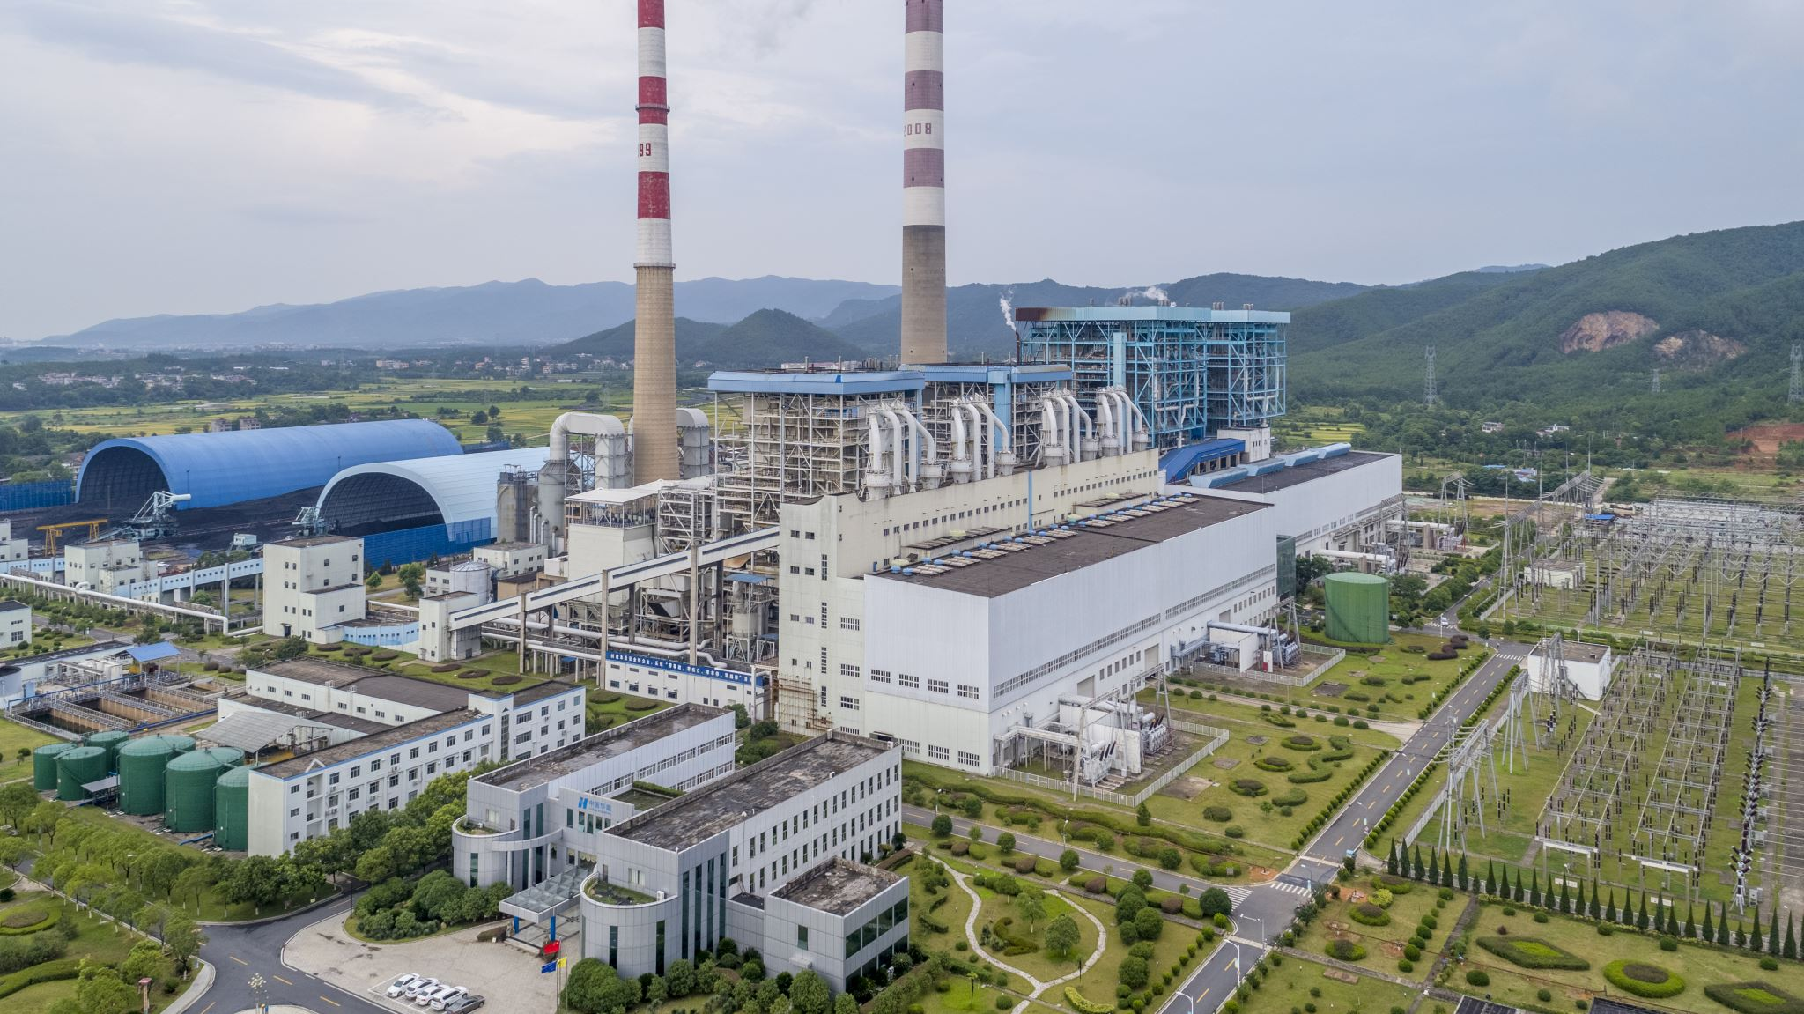
Transformer architecture

Slide 25
Concepts
Overview
High level end-to-end view
Detailed look at important components

Slide 26
Overview
Output sequence
Transformer
Input sequence
Notes:
Just another neural network which processes sequences

Slide 27
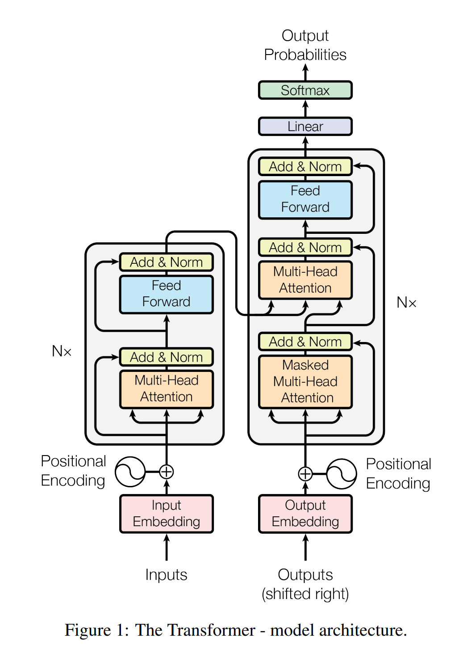
Transformer architecture
Introduced in “Attention Is All You Need“
Encoder-Decoder architecture
Introduced for Language translation
Source: “Attention Is All You Need“
Notes:
Seems overwhelming, but we will dissect it

Slide 28
Encoder Decoder Transformers
Hidden state
Encoder
Decoder
Introduced in “Attention Is All You Need“
Encoder-Decoder architecture
Initially applied to language translation
Source: “Attention Is All You Need“

Slide 29
Decoder only Transformers
Completely skips Encoder stack
Used for Language modeling
Powers the GPT models
Notes:
This is what we will discuss, because of time limit, and also because once this is understood, understanding full encoder / decoder is straightforward.
Also, this is the variant which powers GPT.

Slide 30
Decoder only Transformers (simplified)
Output sequence
Decoder only Transformer
[N]
Output layer
Decoder blocks
Positional Embeddings
Token Embeddings
Tokens
Input sequence
Notes:
A simplified version which we will use as a reference in the rest of the talk.

Slide 31
Decoder only Transformers (simplified)
Output sequence
Decoder only Transformer
Output layer
Decoder block N
…
Decoder block 2
Decoder block 1
Positional Embeddings
Token Embeddings
Tokens
Input sequence
Notes:
Just an expanded form depicting that decoder blocks are layered one after the other.

Slide 32
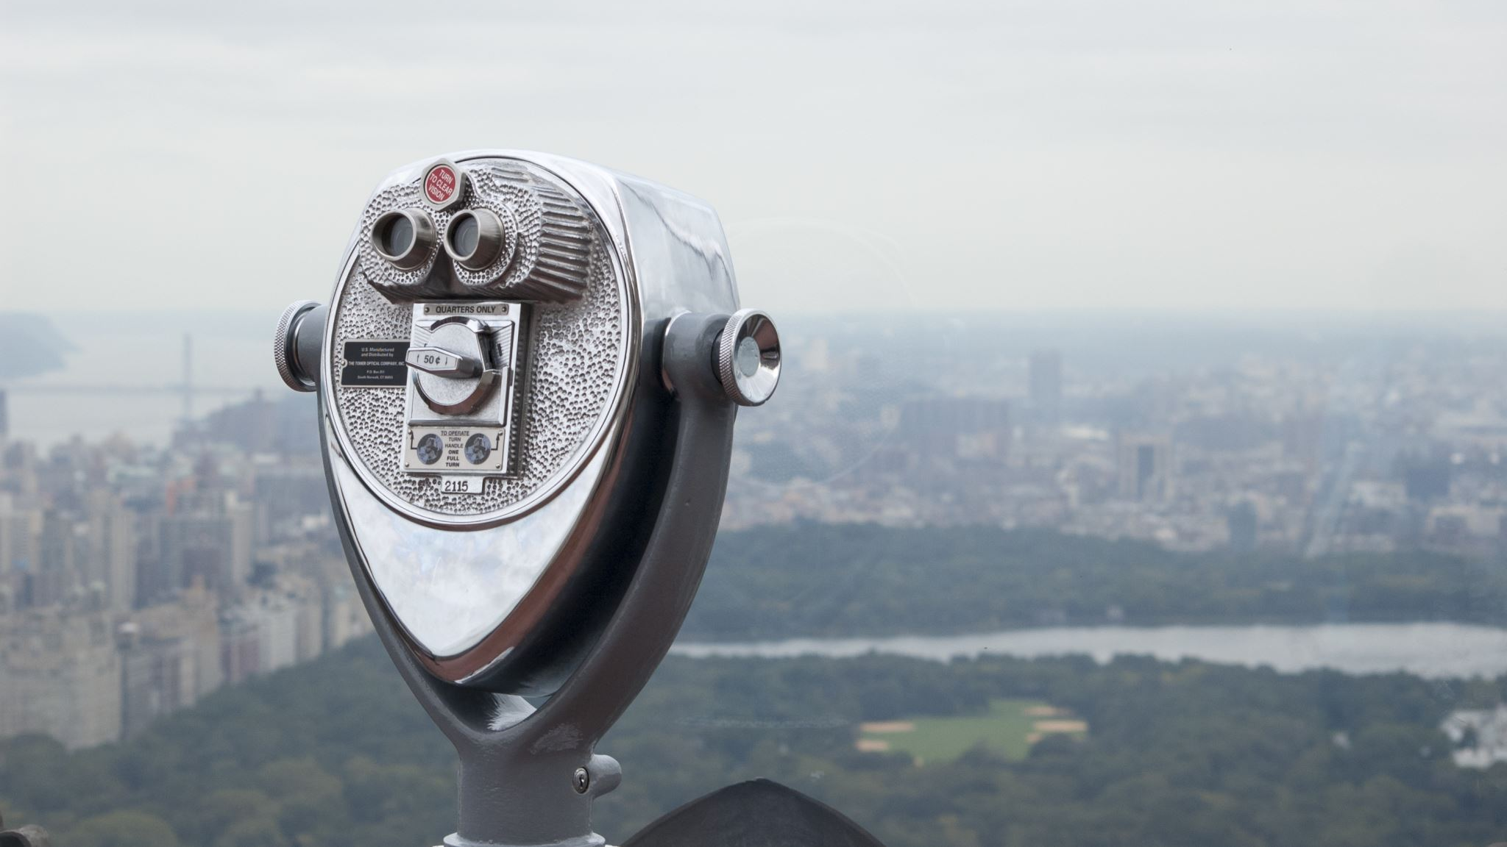
High-level view

Slide 33
Concepts
Vocabulary and Tokenization
Token embeddings and Positional embeddings
Decoder blocks
Generate output
Notes:
We are discussing this architecture in the context of text processing, but most of this applies to other modalities as well.

Slide 34
Vocabulary
Token IDs
Index | Words
0 | a
1 | an
2 | am
3 | bat
4 | ball
…
N | zebra
Tokens / words
Notes:
Input sequence is in the form of text, which is divided into words. If we gather all the words which we are going to use in training the transformer model, we get a vocabulary.

Slide 35
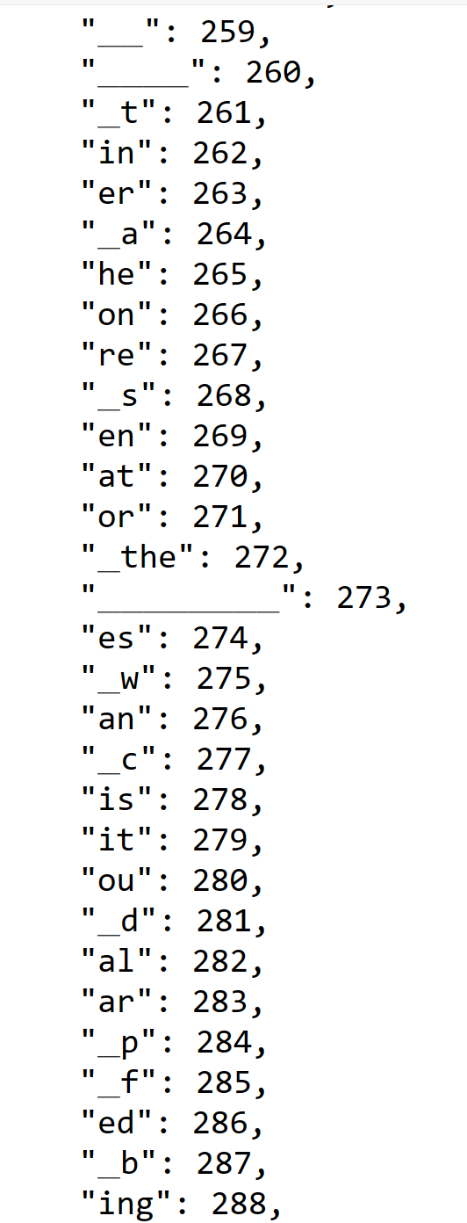
Vocabulary in reality
Token IDs
Tokens / Sub-words
Ref: Mistral-7b-Instruct
Notes:
In reality, the vocabulary consists of sub-words. Because number of words can be huge, maybe in hundereds of thousands. So, a better approach is to make use of sub-words in the vocabulary. For example, there can be many words which end with ‘ing’, like running, jogging, etc. if we use subwords, we can represent all of these words by keeping ‘ing’ as a separate token.

Slide 36
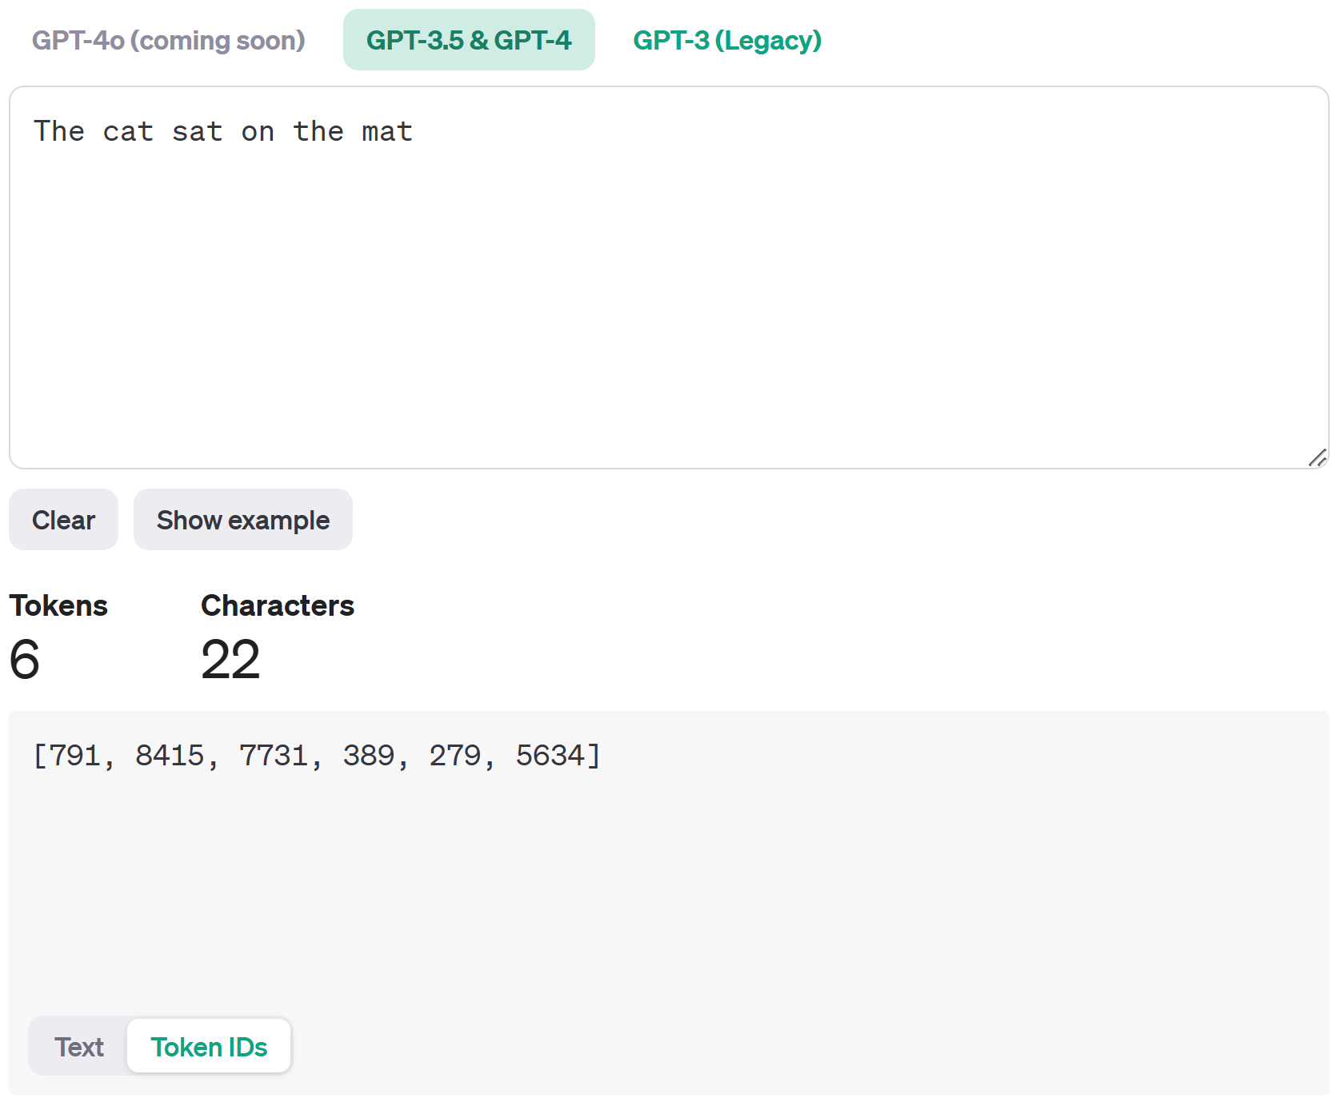
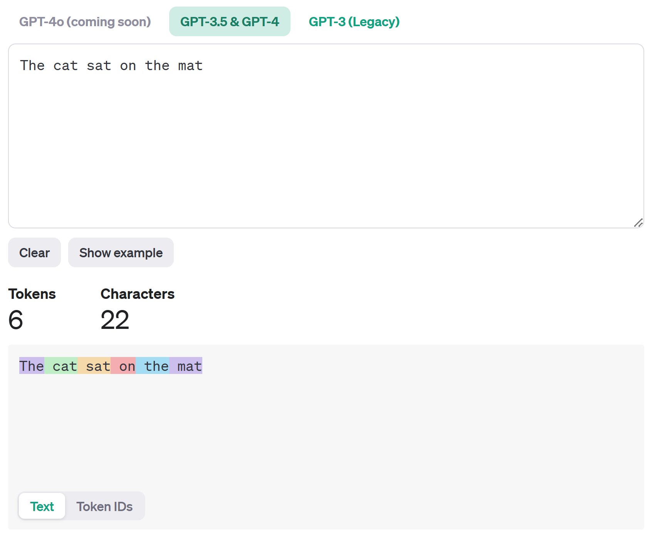
Tokenization
Token IDs
Tokens
OpenAI Platform
Notes:
We have vocabulary in place, we can simply convert the input sequence into tokens by using the indices of sub-words.

Slide 37
Input and output tokens
Output
The cat sat on the mat
Tokens
The | cat | sat | on | the | mat
Token IDs
[791, 8415, 7731, 389, 279, 5634]
Transformer
Tokens
The | cat | sat | on
Token IDs
[791, 8415, 7731, 389]
Input
The cat sat on
Notes:
An example, we input an input sequence which gets converted into tokens and token ids, which are fed to the transformer model, which outputs a sequence of token ids, which then get converted back into an output sequence of text.

Slide 38
Token Embeddings
Convert each token into a vector in an embedding space
Represents semantic meaning of a token
Related tokens are closer to each other
Can be thought of as features automatically learnt by the model during training
Transformer model works on embeddings (and not token ids)
Tokens
The | cat | sat | on
Token IDs
791 | 8415 | 7731 | 389
Token embeddings
-0.12
2.19
1.87
-2.33
0.02
…
…
0.44
2.54
-1.02
1.27
0.21
2.99
…
…
1.22
2.99
0.91
-2.48
1.81
-0.93
…
…
1.90
-1.65
1.38
-1.76
2.03
-0.39
…
…
2.17
Notes:
Once we have tokens, next we convert them into token embeddings which are nothing but high dimensional vectors in an embedding space.

Slide 39
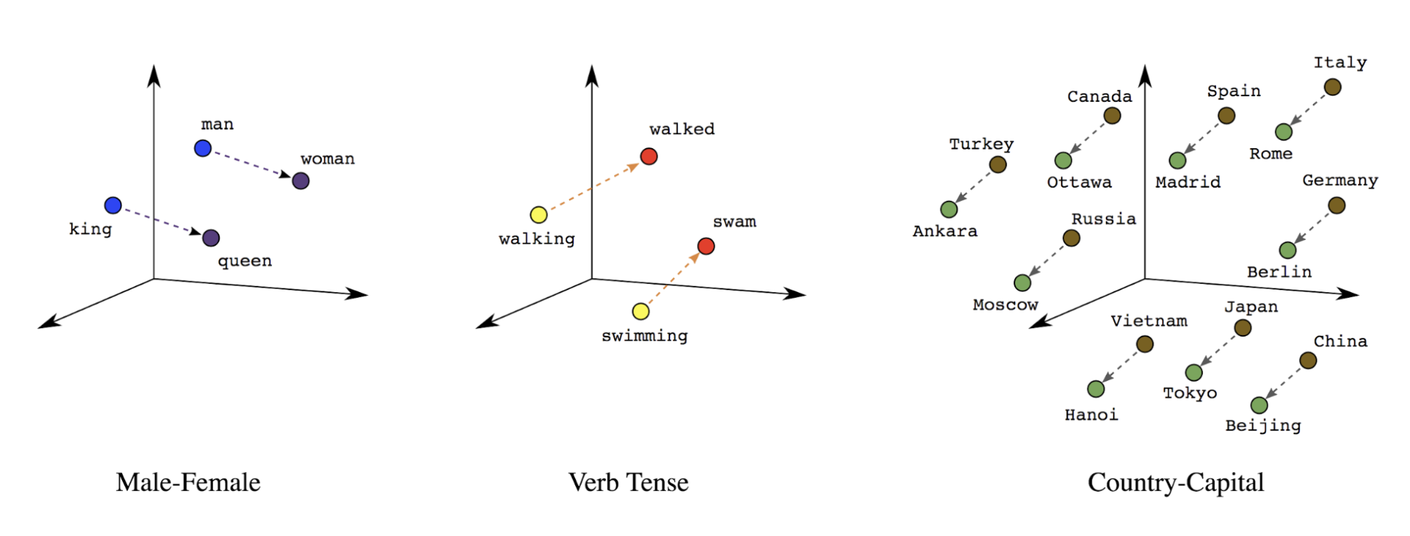
Embeddings intuition
queen – king = man – woman
Reference
Notes:
Related words are closer to each other in the embedding space

Slide 40
Positional embeddings
The cat sat on the mat
Allow the model to differentiate same word at different positions
Can be learned or can be predefined
GPT learns positional embeddings during training
!=
The mat sat on the cat
Notes:
After converting tokens into embedding vectors, next we add information related to the position of words. Transformers are not sequential like RNNs, so there is no inherent assumption about the position of a word in the transformers. That’s why the position information is added to the embedding vector.

Slide 41
Decoder block
Next token
Output layer
Decoder block
Feed forward
Attention
Embedding
Token
Notes:
After obtaining the embeddings for the token, next the token passes through one or more decoder blocks.

Slide 42
Decoder block
Next token
Output
Decoder block
Feed forward
Attention
Embedding
Token
Notes:
A decoder block consists of two sub layers called Attention and feed forward.

Slide 43
Output layer
Convert output from the last Decoder block to the predicted token
Reverse of embedding
Decoder
output
Output layer
0.21
1.92
0.18
-3.22
2.00
…
-1.24
Token ID
Token
279
the
Notes:
Finally, after decoder block, we have an output layer.

Slide 44
What we covered…
Output sequence
Decoder only Transformer
Output layer
Decoder block N
…
Decoder block 2
Decoder block 1
Positional Embeddings
Token Embeddings
Tokens
Input sequence
Notes:
This is what we covered, note that this entire process is performed for each token.

Slide 45

Let us dig deeper
Notes:
Now let’s dig deeper into a few important components which we missed earlier.

Slide 46
Concepts
Decoder block
Attention sublayer
Feed forward sublayer
Residual connections
Stacking multiple decoder blocks
Output layer

Slide 47
Decoder block
Next token
Output
Feed forward
Attention
Embedding
Token

Slide 48
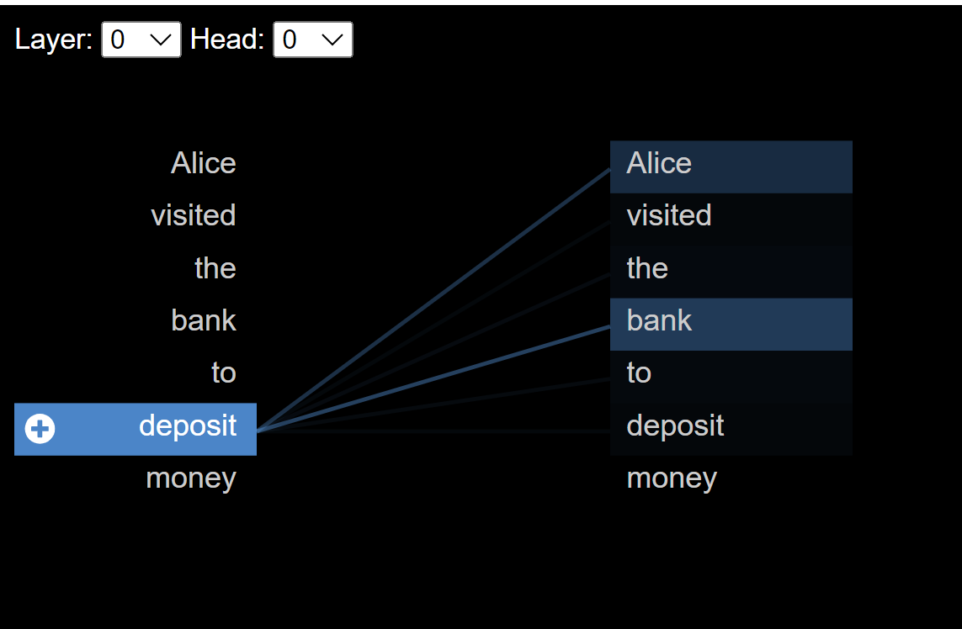
Attention
Contextual meaning of a token
Long range dependencies
Focus on relevant parts of the input

Slide 49
Attention motivation
Dog crossed the road because it was tired Dog crossed the road because it was narrow
Alice visited the bank to deposit money Alice visited the banks of a nearby river

Slide 50
Attention motivation
Multiple meanings of the word bank:
Financial institution
River bank
Power bank
Blood bank
Phrase like – You can bank on me
The meaning depends upon the context!

Slide 51
Goal
Tokens
Alice | visited | the | bank | to | deposit | money
Enrich the embedding vectors with information from the other embeddings in the context
Token IDs
791 | 8415 | 7731 | 389 | 443 | 912 | 656
Token embeddings
-0.12
2.19
1.87
-2.33
0.02
…
…
0.44
2.54
-1.02
1.27
0.21
2.99
…
…
1.22
2.99
0.91
-2.48
1.81
-0.93
…
…
1.90
-1.65
1.38
-1.76
2.03
-0.39
…
…
2.17
0.25
0.44
-0.91
0.34
1.11
…
…
1.99
1.21
1.92
-0.78
1.32
2.93
…
…
1.02
-2.17
1.83
-1.09
0.03
-2.12
…
…
0.84

Slide 52
Goal
Tokens
Alice | visited | the | bank | to | deposit | money
Enrich the embedding vectors with information from the other embeddings in the context
Token IDs
791 | 8415 | 7731 | 389 | 443 | 912 | 656
Token embeddings
-0.12
2.19
1.87
-2.33
0.02
…
…
0.44
2.54
-1.02
1.27
0.21
2.99
…
…
1.22
2.99
0.91
-2.48
1.81
-0.93
…
…
1.90
-1.65
1.38
-1.76
2.03
-0.39
…
…
2.17
0.25
0.44
-0.91
0.34
1.11
…
…
1.99
1.21
1.92
-0.78
1.32
2.93
…
…
1.02
-2.17
1.83
-1.09
0.03
-2.12
…
…
0.84
bank = bank + context

Slide 53
Goal
…
Alice
visited
the
money
token1
token2
token3
tokenN
bank
token4
Attention
Context vector
+
Context enriched embedding
for token4 (“bank”)

Slide 54
Goal
…
Alice
visited
the
money
token1
token2
token3
tokenN
bank
token4
Attention
Calculate Attention for all tokens 1..N
Obtain context enriched embeddings for all tokens
Context vector
+
Context enriched embedding
for token4 (“bank”)

Slide 55
Types of Attention
Self attention
Causal attention
Encoder
Decoder
Cross attention

Slide 56
Types of Attention
Self attention
Causal attention
Encoder
Decoder
Cross attention

Slide 57
Self attention
Learn relevance and dependencies between all input tokens
Self attention

Slide 58
Self Attention
 | Alice | visited | the | bank | to | deposit | money
Alice
visited
the
bank
to
deposit
money

Slide 59
Simplified Self Attention
Attention scores = similarity between all tokens’ embedding vectors
Similarity between vectors → Vector dot product
Attention weights = Softmax (Attention scores)

Slide 60
Simplified Self Attention
…
Alice
visited
the
money
bank
token1
token2
token3
tokenN
token4
.
.
.
.
…
score1
score2
score3
scoreN
Softmax
token1
w1
token2
w2
token3
w3
tokenN
wN
X
X
X
X
+
context vector for token 4

Slide 61
Simplified Self Attention
All input tokens
…
Alice
visited
the
money
bank
token1
token2
token3
tokenN
Input token for which attention is being calculated
token4
.
.
.
.
Attention scores
…
score1
score2
score3
scoreN
Softmax
token1
w1
token2
w2
token3
w3
tokenN
wN
X
X
X
X
Attention weights
+
context vector for token 4

Slide 62
Simplified Self Attention
…
Alice
visited
the
money
bank
token1
token2
token3
tokenN
token4
.
.
.
.
There are no weights which can be optimized during training to improve performance
…
score1
score2
score3
scoreN
Softmax
token1
w1
token2
w2
token3
w3
tokenN
wN
X
X
X
X
+
context vector for token 4

Slide 63
Adding trainable weights
Model attention as a Search problem
For each token search for other relevant tokens
Then copy relevant information from the relevant tokens

Slide 64

Attention as a Search problem
Query
Key
Value = actual content

Slide 65
Attention as a Search problem
Query
Alice | visited | the | bank | to | deposit | money
Keys
Values

Slide 66
Trainable Self Attention
Trainable
weights
q1
Wq
q2
queries
Token
embeddings
q3
qN
t1
t2
Wk
k1
t3
k2
keys
k3
kN
tN
Wv
v1
v2
values
v3
vN

Slide 67
Trainable Self Attention
…
key1
key2
key3
keyN
query4
.
.
.
.
…
score1
score2
score3
scoreN
Softmax
value1
w1
value2
w2
value3
w3
valueN
wN
X
X
X
X
+
context vector

Slide 68
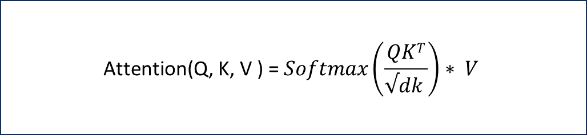
Trainable Self Attention
…
key1
key2
key3
keyN
query4
.
.
.
.
…
$$\text{Attention}\text{(}\text{Q}\text{, }\text{K}\text{, }\text{V}\text{ ) =} Softmax\left(\frac{QKT}{√dk }\right)∗ V$$
score1
score2
score3
scoreN
Softmax
value1
w1
value2
w2
value3
w3
valueN
wN
X
X
X
X
+
context vector

Slide 69
Example: Self attention weights
 | Alice | visited | the | bank | to | deposit | money
Alice | 0.1 | 0.2 | 0.01 | 0.2 | 0.09 | 0.2 | 0.2
visited | 0.3 | 0.1 | 0.04 | 0.3 | 0.06 | 0.2 | 0.2
the | 0.1 | 0.2 | 0.1 | 0.2 | 0.1 | 0.2 | 0.1
bank | 0.2 | 0.2 | 0.02 | 0.1 | 0.08 | 0.2 | 0.2
to | 0.2 | 0.1 | 0.2 | 0.1 | 0.2 | 0.1 | 0.1
deposit | 0.1 | 0.1 | 0.05 | 0.3 | 0.05 | 0.1 | 0.3
money | 0.1 | 0.0 | 0.01 | 0.4 | 0.09 | 0.3 | 0.1

Slide 70
Causal attention
Attention between a token and all the previous tokens in the sequence
Future tokens are ignored/masked
Causal attention

Slide 71
Example: Causal attention weights
 | Alice | visited | the | bank | to | deposit | Money
Alice | 1.0
visited | 0.7 | 0.3
the | 0.2 | 0.6 | 0.2
bank | 0.4 | 0.4 | 0.05 | 0.15
to | 0.3 | 0.1 | 0.3 | 0.1 | 0.2
deposit | 0.2 | 0.2 | 0.05 | 0.3 | 0.05 | 0.2
money | 0.1 | 0.0 | 0.01 | 0.4 | 0.09 | 0.3 | 0.1

Slide 72

Multi-head attention
Multiple sets of trainable weights instead of just one
Helps capture a richer set of relationships between tokens

Slide 73
Multi-head Attention
Trainable weights per head
q1
Wq
q1
Wq
q1
Wq
q2
q2
q2
q3
queries per head
q3
Token
embeddings
q3
qN
qN
qN
t1
k1
t2
Wk
k1
Wk
k1
Wk
k2
t3
k2
k2
keys per head
k3
k3
k3
kN
kN
kN
tN
v1
v1
Wv
v1
Wv
Wv
v2
v2
v2
values per head
v3
v3
v3
vN
vN
vN

Slide 74
Multi-head Attention
k1
k2
k3
kN
k1
k2
k3
kN
key1
key2
key3
keyN
q3
q3
query4
.
.
.
.
…
s1
s2
s3
sN
s1
s2
s3
sN
score1
score2
score3
scoreN
Softmax
v1
w1
v2
w2
v3
w3
vN
wN
v1
w1
v2
w2
v3
w3
vN
wN
value1
w1
value2
w2
value3
w3
valueN
wN
X
X
X
X
+
per-head vector
per-head vector
per-head vector
Wo
concatenate
Concatenated vector
X
Context vector

Slide 75
Multi-head Attention
k1
k2
k3
kN
k1
k2
k3
kN
key1
key2
key3
keyN
q3
q3
query4
.
.
.
.
…
s1
s2
s3
sN
s1
s2
s3
sN
score1
score2
score3
scoreN
MultiHead(Q, K, V ) = Concat(head1, ..., headH)Wo
Softmax
v1
w1
v2
w2
v3
w3
vN
wN
v1
w1
v2
w2
v3
w3
vN
wN
value1
w1
value2
w2
value3
w3
valueN
wN
X
X
X
X
+
per-head vector
per-head vector
per-head vector
Wo
concatenate
Concatenated vector
X
Context vector

Slide 76
Decoder block
Next token
Output
Feed forward
Attention
Embedding
Token

Slide 77
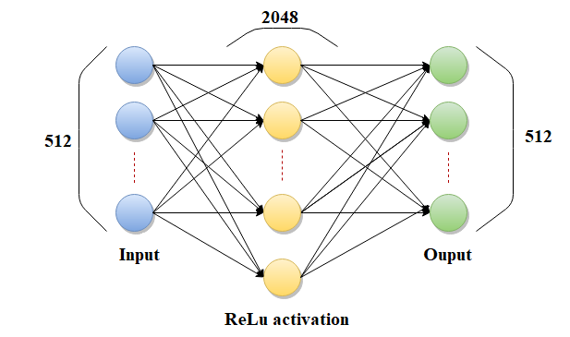
Feed forward sublayer

Slide 78
Feed forward sublayer
The only place in the network having non-linearity
Enhances the model’s capacity to represent complex, non-linear transformations
Has most of the model weights
Head 1
Head 2
Concat and project
…………………….….
Head 3
…………………….….
Head h

Slide 79
Decoder block
Next token
Output
Feed forward
Attention
Embedding
Token

Slide 80
Residual connections
Next token
Output
Pass positional information to subsequent layers
Critical to training deeper networks
Feed forward
Attention
Embedding
Token

Slide 81
Multi layered
Decoder block N
…
Multiple layers help in building deeper network, thereby increasing the learning capacity of the model
Subsequent layers can build upon previous layers’ results and can learn more complex scenarios
Decoder block 2
Decoder block 1

Slide 82
Multi layer Decoder stack
Next token
Output
Feed forward
Attention
…
Feed forward
Attention
Feed forward
Attention
Embedding
Token

Slide 83
Multi layer Multi token
Token 2
Token 3
Token N
Output
Output
Output
Feed forward
Feed forward
Feed forward
…
Attention
Attention
Attention
…
…
…
Feed forward
Feed forward
Feed forward
Attention
Attention
Attention
Feed forward
Feed forward
Feed forward
Attention
Attention
Attention
Embedding
Embedding
Embedding
Token 1
Token 2
Token N-1

Slide 84
Output layer
Convert output from the last Decoder block to tokens
Output layer
weights
Logits
Softmax
Probabilities
Argmax
Decoder
output
Weights
4.01
2.33
-5.65
9.92
2.11
-8.31
0.13
…
…
4.19
0.01
0.06
0.03
0.00
0.61
0.01
0.02
…
…
0.17
0.21
1.92
0.18
-3.22
2.00
…
-1.24
Token ID
Token
X
279
the

Slide 85
What we covered …
Output sequence
Decoder only Transformer
Output layer
Decoder block N
…
Decoder block 2
Decoder block 1
Positional Embeddings
Token Embeddings
Tokens
Input sequence

Slide 86
What we didn’t cover …
Layer norms
Regularization

Slide 87

Inference and Training

Slide 88
Inference
Token 2
Token 3
Token N
Output
Output
Output
Decoder
Decoder
Decoder
…
Generate token sequence one token at a time
…
…
…
Decoder
Decoder
Decoder
Decoder
Decoder
Decoder
Embedding
Embedding
Embedding
Token 1
Token 2
Token N-1

Slide 89
Timestep 1
visited
Token 2
Output
Decoder
Input token ‘Alice’
Output token ‘the’
…
Decoder
Decoder
Embedding
Token 1
Alice

Slide 90
Timestep 2
visited
the
Token 2
Token 3
Output
Output
Decoder
Decoder
Input tokens ‘Alice’ and ‘visited’
Output token ‘the’
…
…
Decoder
Decoder
Decoder
Decoder
Embedding
Embedding
Token 1
Token 2
Alice
visited

Slide 91
Timestep 3
visited
the
bank
Token 2
Token 3
Token 3
Output
Output
Output
Decoder
Decoder
Decoder
Input tokens ‘Alice’, ‘visited’, ‘the’
Output token ‘bank’
…
…
…
Decoder
Decoder
Decoder
Decoder
Decoder
Decoder
Embedding
Embedding
Embedding
Token 1
Token 2
Token 2
Alice
visited
the

Slide 92
Timestep 3
visited
the
bank
Token 2
Token 3
Token 3
Output
Output
Output
Decoder
Decoder
Decoder
Continues till end of the sequence
For all the input sequences
Input tokens ‘Alice’, ‘visited’, ‘the’
Output token ‘bank’
…
…
…
Decoder
Decoder
Decoder
Decoder
Decoder
Decoder
Embedding
Embedding
Embedding
Token 1
Token 2
Token 2
Alice
visited
the

Slide 93
Training
Pretraining
Fine-tuning

Slide 94
Pretraining
The
cat
Learn to predict next word aka Causal modeling
Unsupervised learning on a large corpus of text
The
cat
sat
The
cat
sat
on
The
cat
sat
on
the
The
cat
sat
on
the
mat

Slide 95
Pretraining example
Canada is a country in North America. Its ten provinces and three territories extend from the Atlantic Ocean to the Pacific Ocean and northward into the Arctic Ocean, making it the world's second-largest country by total area, with the world's longest coastline. Its border with the United States is the world's longest international land border. The country is characterized by a wide range of both meteorologic and geological regions. It is a sparsely inhabited country of 40 million people, the vast majority residing south of the 55th parallel in urban areas. Canada's capital is Ottawa and its three largest metropolitan areas are Toronto, Montreal, and Vancouver.

Slide 96
Pretraining example
Canada is a country in North America. Its ten provinces and three territories extend from the Atlantic Ocean to the Pacific Ocean and northward into the Arctic Ocean, making it the world's second-largest country by total area, with the world's longest coastline. Its border with the United States is the world's longest international land border. The country is characterized by a wide range of both meteorologic and geological regions. It is a sparsely inhabited country of 40 million people, the vast majority residing south of the 55th parallel in urban areas. Canada's capital is Ottawa and its three largest metropolitan areas are Toronto, Montreal, and Vancouver.

Slide 97
Pretraining example
Canada is a country in North America. Its ten provinces and three territories extend from the Atlantic Ocean to the Pacific Ocean and northward into the Arctic Ocean, making it the world's second-largest country by total area, with the world's longest coastline. Its border with the United States is the world's longest international land border. The country is characterized by a wide range of both meteorologic and geological regions. It is a sparsely inhabited country of 40 million people, the vast majority residing south of the 55th parallel in urban areas. Canada's capital is Ottawa and its three largest metropolitan areas are Toronto, Montreal, and Vancouver.

Slide 98
Pretraining example
Canada is a country in North America. Its ten provinces and three territories extend from the Atlantic Ocean to the Pacific Ocean and northward into the Arctic Ocean, making it the world's second-largest country by total area, with the world's longest coastline. Its border with the United States is the world's longest international land border. The country is characterized by a wide range of both meteorologic and geological regions. It is a sparsely inhabited country of 40 million people, the vast majority residing south of the 55th parallel in urban areas. Canada's capital is Ottawa and its three largest metropolitan areas are Toronto, Montreal, and Vancouver.

Slide 99
Pretraining details
Token 2
Token 3
Token N
Output
Output
Output
Decoder
Decoder
Decoder
…
Generate entire token sequences at the same time
Calculate and backpropagate the loss
Update the weights
Repeat
…
…
…
Decoder
Decoder
Decoder
Decoder
Decoder
Decoder
Embedding
Embedding
Embedding
Token 1
Token 2
Token N-1

Slide 100
Forward pass
<random>
<random>
<random>
Token 2
Token 3
Token N
Output
Output
Output
Decoder
Decoder
Decoder
…
Input ‘Alice’, ‘visited’, ‘the’, ‘bank’, ‘to’, ‘deposit’, ‘money’
Output random tokens
…
…
…
Decoder
Decoder
Decoder
Decoder
Decoder
Decoder
Embedding
Embedding
Embedding
Token 1
Token 2
Token N-1
Alice
visited
money

Slide 101
Training loss
Labels
‘visited’ ‘the’ ‘end-of-sequence’
Outputs
<random> <random> <random>
Token 2
Token 3
Token N
Output
Output
Output
Decoder
Decoder
Decoder
…
Loss = Y – Y’ = Labels - Outputs
…
…
…
Decoder
Decoder
Decoder
Decoder
Decoder
Decoder
Embedding
Embedding
Embedding
Token 1
Token 2
Token N-1
Alice
visited
money

Slide 102
Backprop
Labels
‘visited’ ‘the’ ‘end-of-sequence’
Outputs
<random> <random> <random>
Token 2
Token 3
Token N
Output
Output
Output
Decoder
Decoder
Decoder
…
Backpropagate the loss
Update the weights
Backpropagate Loss
…
…
…
Decoder
Decoder
Decoder
Decoder
Decoder
Decoder
Embedding
Embedding
Embedding
Token 1
Token 2
Token N-1
Alice
visited
money

Slide 103
Repeat
Labels
‘visited’ ‘the’ ‘end-of-sequence’
Outputs
<random> <random> <random>
Token 2
Token 3
Token N
Forward pass
Output
Output
Output
Decoder
Decoder
Decoder
…
…
…
…
Decoder
Decoder
Loss
Decoder
Update weights
Decoder
Decoder
Decoder
Backpropagate loss
Embedding
Embedding
Embedding
Token 1
Token 2
Token N-1
Alice
visited
money

Slide 104
Fine tuning
Align pre-trained transformers towards a specific task, for example a Chat assistant.
Supervised learning

Slide 105
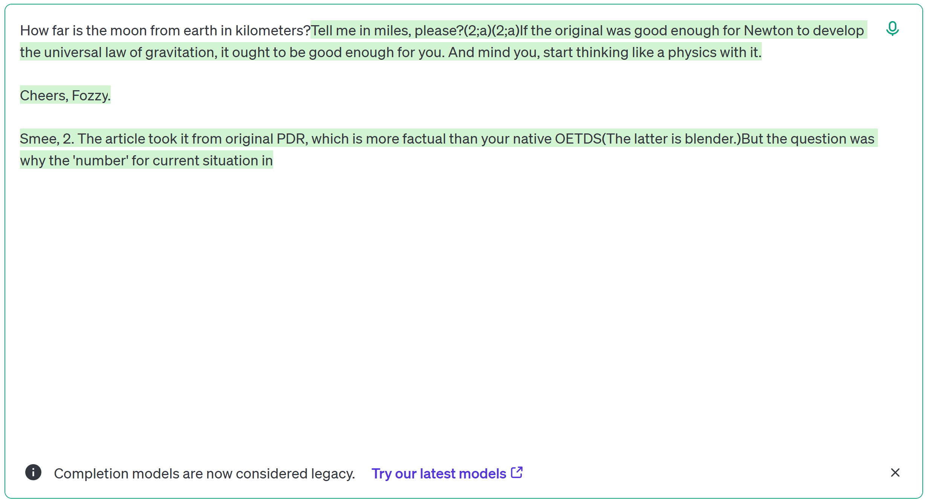
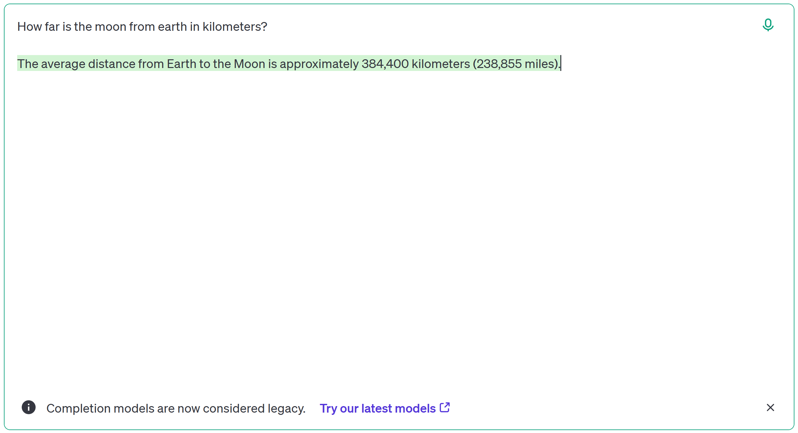
Why Fine tuning?
Base model
Instruction tuned model
davinci-002
gpt 3.5 turbo

Slide 106

Real world example

Slide 107
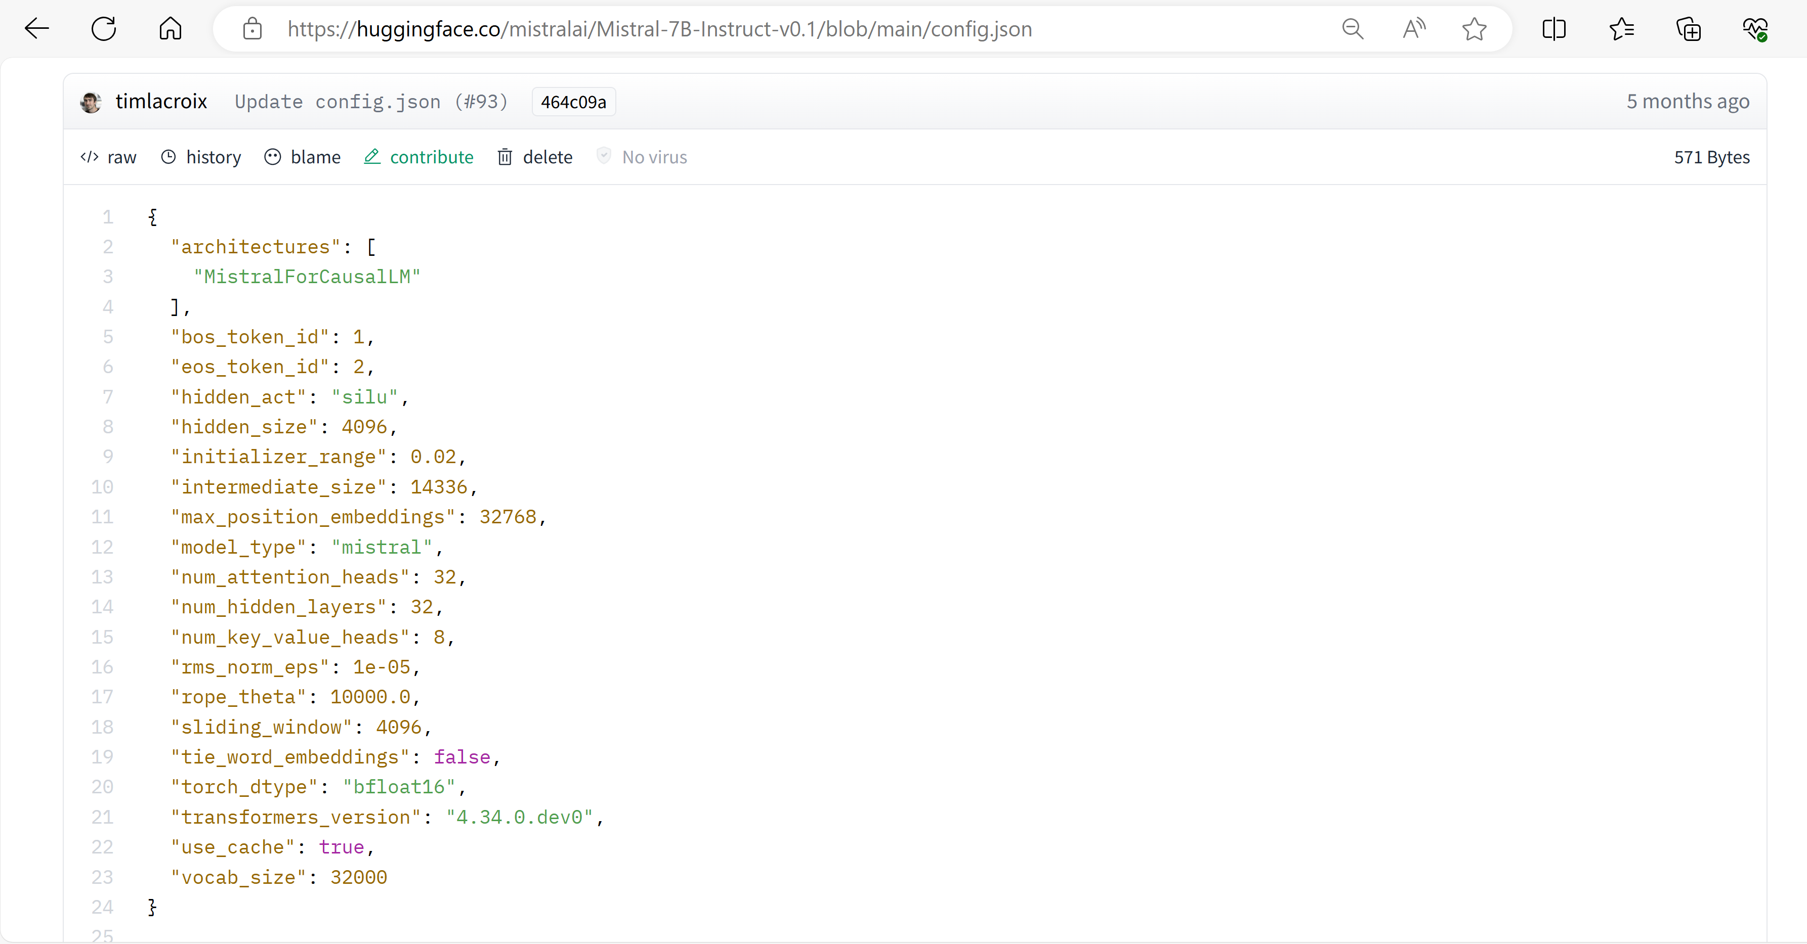
Embedding dimension
Number of nodes in Feed forward hidden layer
Max input sequence length
Number of attention heads in each decoder block
Number of decoder blocks
Vocabulary size

Slide 108
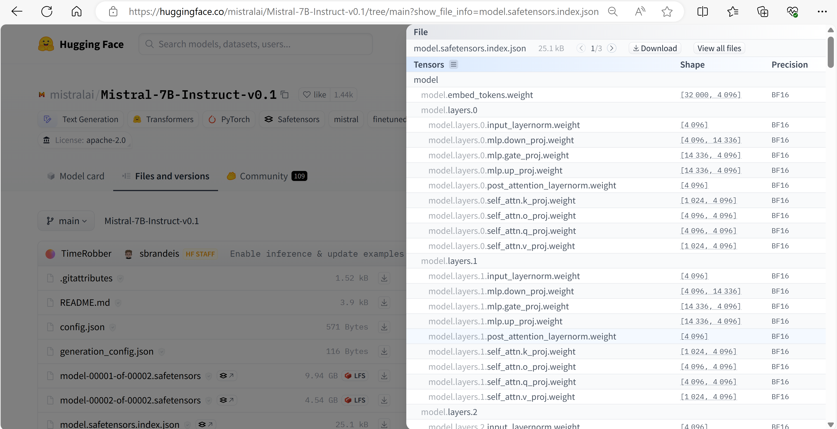

Slide 109
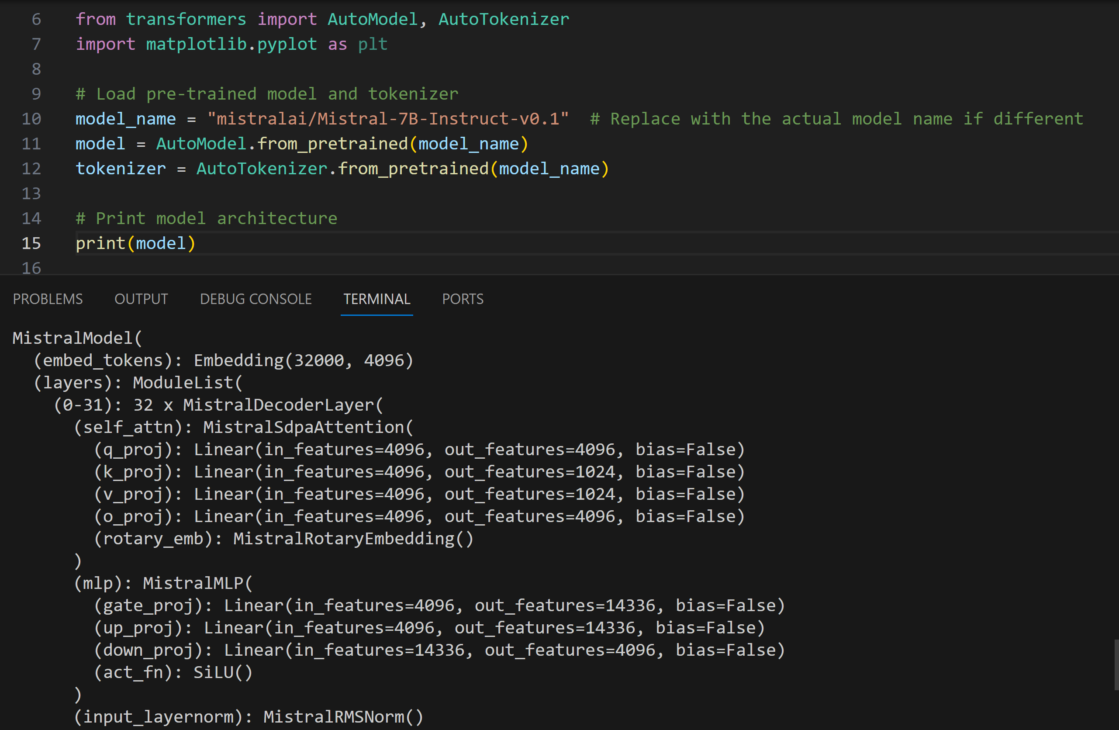

Slide 110
References
[1706.03762] Attention Is All You Need (arxiv.org) by Vaswani et al.
Build a large language model from scratch by Sebastian Raschka
GitHub - karpathy/minGPT: A minimal PyTorch re-implementation of the OpenAI GPT (Generative Pretrained Transformer) training by Andrej Karpathy
LM Debugger

Slide 111
Thank you!

Slide 112
Q & A

Slide 115
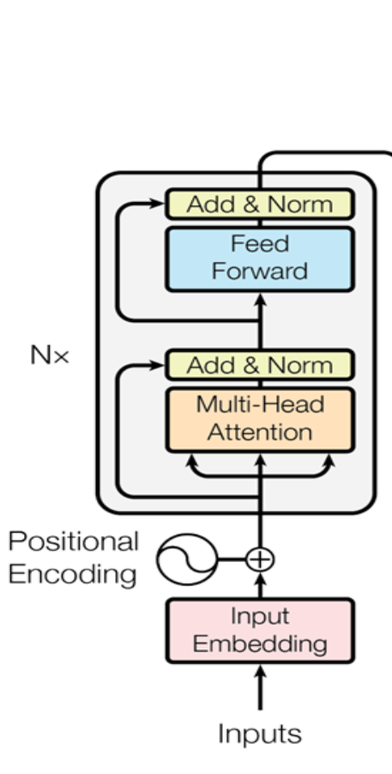
Encoder stack
Input embeddings
Positional encoding
Sub layer: Multi head attention
Sub layer: Feed forward network

Slide 116
N tokens
Token 2
Token 3
Token N-1
Token N
Unembed
Unembed
Unembed
Feed forward
Feed forward
Feed forward
…
Attention
Attention
Attention
…
…
…
Feed forward
Feed forward
Feed forward
Attention
Attention
Attention
Feed forward
Feed forward
Feed forward
Attention
Attention
Attention
Embedding
Embedding
Embedding
Token 1
Token 2
Token 3
Token N-1

Slide 117
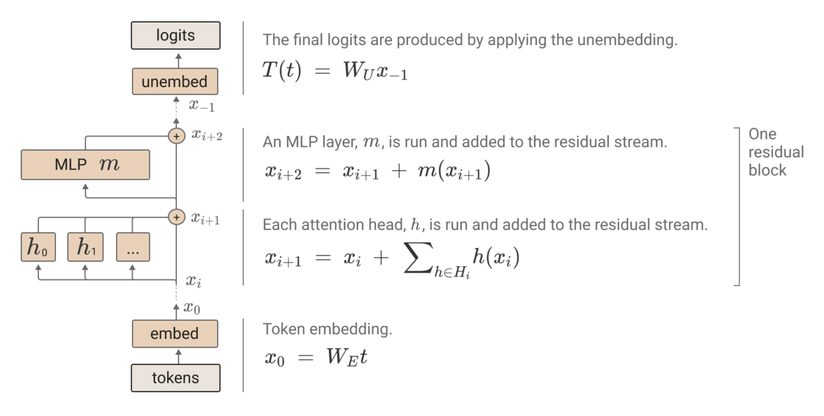
Simplified view

Slide 118
Cross attention
TBD

Slide 119
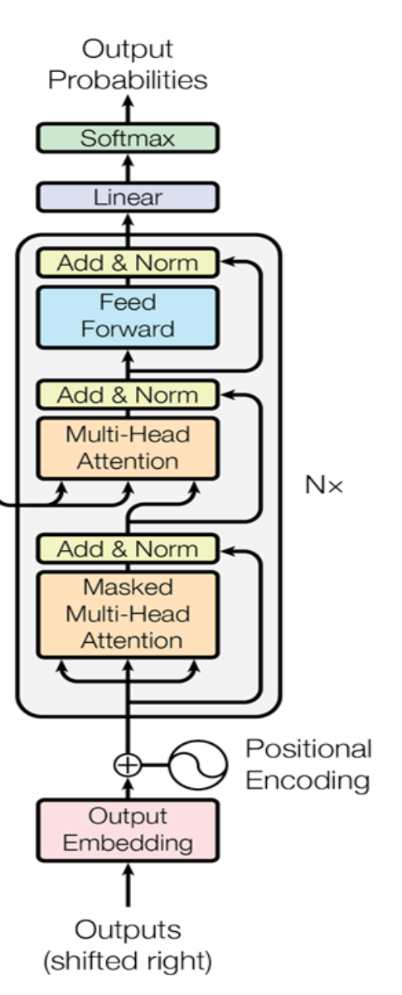
Decoder stack
Output embeddings
Sub layer: Multi head attention
Sub layer: Feed forward network

Slide 120
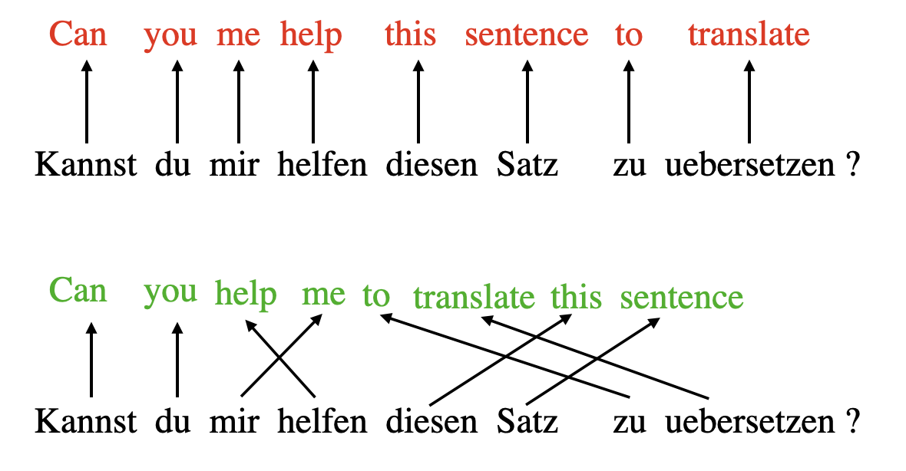
Self-attention

Slide 121
Trainable Attention
k1
k2
k3
kN
q3
.
.
.
…
.
w1
w2
w3
wN
Softmax
n1
n2
n3
nN
v1
v2
v2
vN
X
X
X
X
+
Output vector
kN = xN @ Wk
qN = xN @ Wq
vN = xN @ Wv

Slide 122
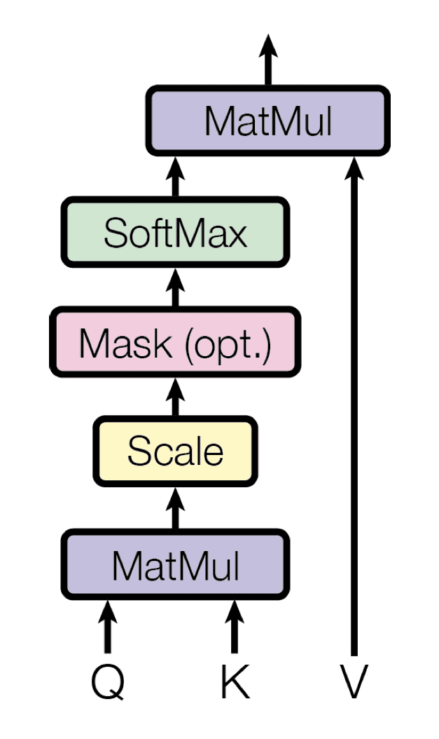
Implementation of Attention - Visualized

Slide 123
Trainable Self Attention
k1
k2
k3
kN
q3
.
.
.
.
…
s1
s2
s3
sN
Softmax
v1
w1
v2
w2
v3
w3
vN
wN
X
X
X
X
+
kN = xN @ Wk
qN = xN @ Wq
output vector
vN = xN @ Wv

Slide 124
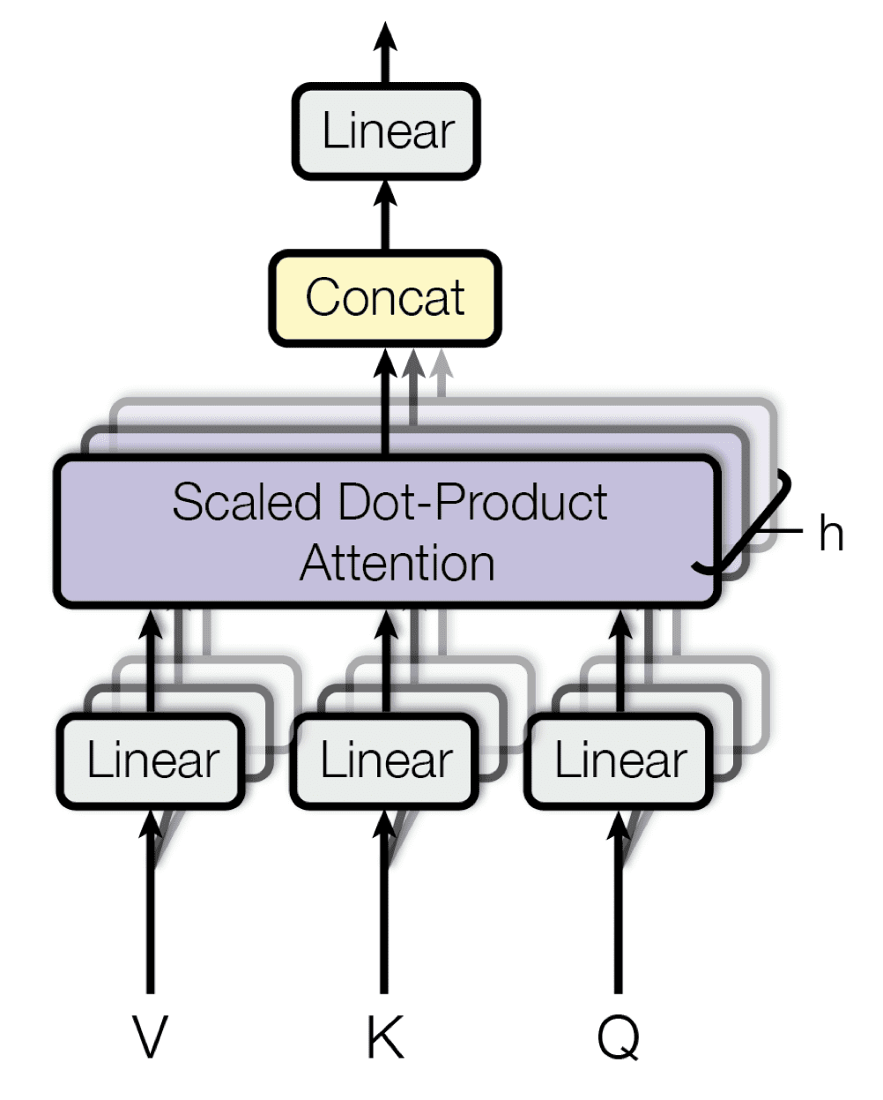
Multi-head Attention
Extract multiple features

Slide 125
Implementation of Attention - I
Key, Query, Value
Query = Current token
Keys = All tokens
Values = Values to be used for calculating attention score

Slide 126
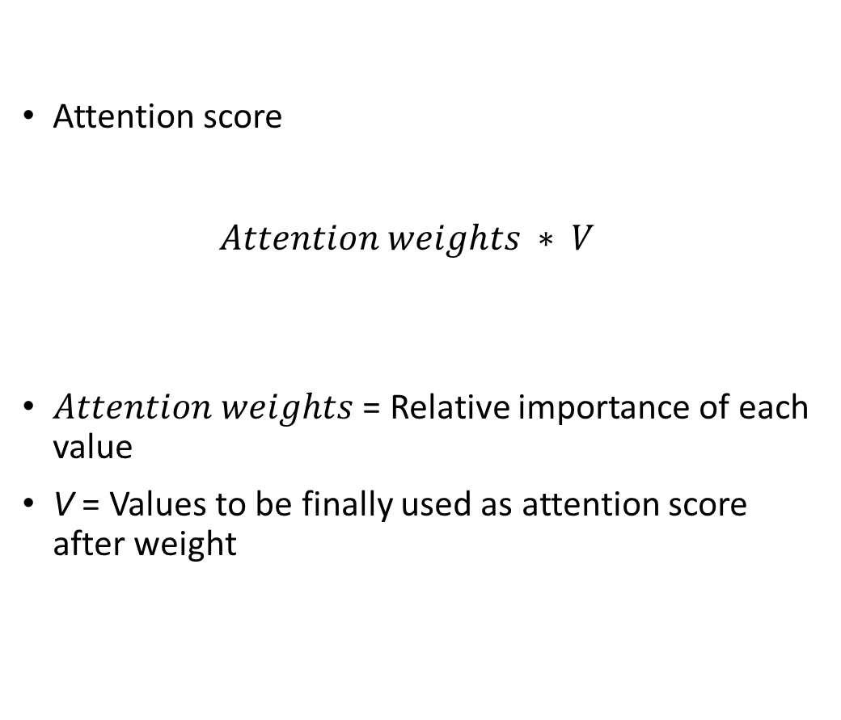
Implementation of Attention - II
Attention score $Attention weights ∗ V$
$Attention weights$ = Relative importance of each value
V = Values to be finally used as attention score after weight

Slide 127
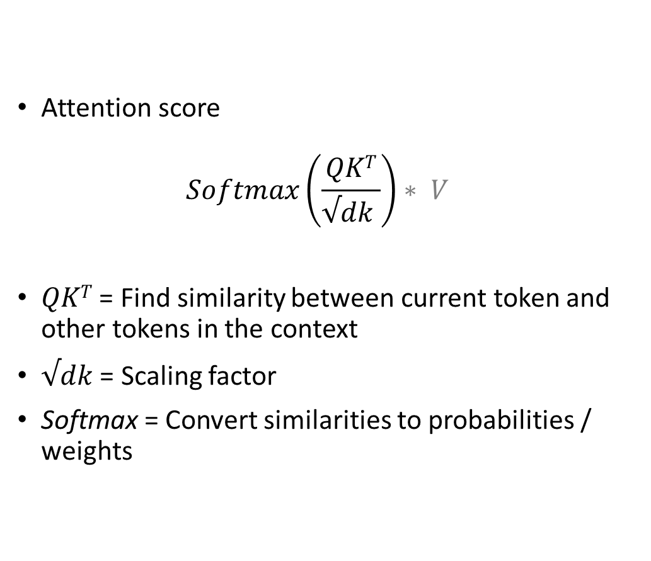
Implementation of Attention - III
Attention score $Softmax\left(\frac{QKT}{√dk }\right)∗ V$
$QKT$ = Find similarity between current token and other tokens in the context
$√dk$ = Scaling factor
Softmax = Convert similarities to probabilities / weights

Slide 128
Encoder decoder architecture
Encoder
Decoder

Slide 129
Basic RNN won’t work for translation
x1
x2
x3
xN
No dependency between inputs.
No concept of input ordering.
…
h0
h1
hN-1
y1
y2
y3
yN
Time

Slide 130
Timestep 2: Predict
<random>
<random>
<random>
Token 2
Token 3
Token N
Output
Output
Output
Decoder
Decoder
Decoder
…
Input ‘The’, ‘cat’, ‘sat’, ‘on’, ‘the’, ‘mat’
Output random tokens
…
…
…
Decoder
Decoder
Decoder
Decoder
Decoder
Decoder
Embedding
Embedding
Embedding
Token 1
Token 2
Token N-1
The
cat
mat

Slide 131
Basic Recurrent neural network
x1
x2
x3
xN
…
h0
h1
hN-1
y1
y2
y3
yN
Time

Slide 132
Basic Recurrent neural network
x1
x2
x3
xN
But, this won’t directly work for language translation
…
h0
h1
hN-1
y1
y2
y3
yN
Time

Slide 133
Basic RNNs won’t work for translation
The
cat
sat
on
the
mat
बिल्ली
चटाई
पर
बैठ
गई

Slide 134
Basic RNNs won’t work for translation
No one-to-one correspondence between inputs and outputs
Input sequence length can be different than output sequence length
The
cat
sat
on
the
mat
बिल्ली
चटाई
पर
बैठ
गई

Slide 135
Problems with RNNs
The
cat
sat
on
the
mat
hStart
E
E
E
E
E
E
Bottleneck for long context lengths
h0
h1
h2
h3
h4
h5
<s>
D
D
D
D
D
D
s0
s1
s2
s3
s4
s5
बिल्ली
चटाई
पर
बैठ
गई
<end>

Slide 136
Attention in RNNs (Bahdanau et al. 2014)
The
cat
sat
on
the
mat
hStart
E
E
E
E
E
E
h0
h1
h2
h3
h4
h5
<s>
s0
D
s1
बिल्ली

Slide 137
Attention in RNNs
The
cat
sat
on
the
mat
hStart
E
E
E
E
E
E
h0
h1
h2
h3
h4
h5
<s>
s0
D
s1
D
s1
बिल्ली
चटाई

Slide 138
Attention in RNNs
The
cat
sat
on
the
mat
hStart
E
E
E
E
E
E
h0
h1
h2
h3
h4
h5
<s>
s0
D
s1
D
s2
D
s3
D
s4
D
s5
बिल्ली
चटाई
पर
बैठ
गई

